Slide 1
Virtualization Structures/Tools and Mechanisms
Hypervisor and Xen Architecture
Binary Translation with Full Virtualization
Para-Virtualization with Compiler Support

Slide 2
Virtualization Structures/Tools and Mechanisms
Before virtualization, the operating system manages the hardware.
After virtualization, a virtualization layer is inserted between the hardware and the operating system.
In such a case, virtualization layer is responsible for converting portions of the real hardware into virtual hardware.
Depending on the position of the virtualization layer, there are several classes of VM architectures, namely:
- hypervisor architecture,
- paravirtualization, and
- host-based virtualization.

Slide 3
Hypervisor and Xen Architecture
The hypervisor software sits directly between physical hardware & its OS.
Hypervisor (or VMM) provides hyper calls for the guest OSes & applications.
Depending on the functionality, a hypervisor can assume:
A micro-kernel architecture (Microsoft Hyper-V) or
A monolithic hypervisor architecture (VMware ESX) for server virtualization.
A micro-kernel hypervisor includes only the basic and unchanging functions (such as physical memory management and processor scheduling).
The device drivers and other changeable components are outside the hypervisor.
A monolithic hypervisor implements all the aforementioned functions, including those of the device drivers.
Therefore, size of hypervisor code of a micro-kernel hypervisor is smaller than that of a monolithic hypervisor.

Slide 4
The Xen Architecture
Xen is a microkernel hypervisor, which separates the policy from the mechanism.
The Xen hypervisor implements all the mechanisms, leaving the policy to be handled by Domain 0, as shown in Figure 3.5.
Xen does not include any device drivers natively.
It just provides a mechanism by which a guest OS can have direct access to the physical devices.
As a result, the size of the Xen hypervisor is kept rather small.
Xen provides a virtual environment located between hardware & OS.
Core components of a Xen system are the hypervisor, kernel, and applications.

Slide 5
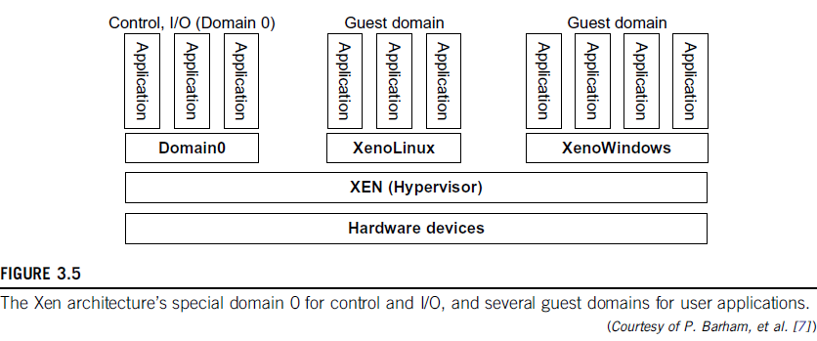

Slide 6
Like other virtualization systems, many guest OSes can run on top of the hypervisor.
However, not all guest OSes are created equal, and one in particular controls the others.
The guest OS, which has control ability, is called Domain 0, and the others are called Domain U.
Domain 0 is a privileged guest OS of Xen. It is first loaded when Xen boots without any file system drivers being available.
Domain 0 is designed to access hardware directly and manage devices.
Therefore, one of the responsibilities of Domain 0 is to allocate and map hardware resources for the guest domains (the Domain U domains).

Slide 7
Binary Translation with Full Virtualization
Depending on implementation technologies, hardware virtualization can be classified into two categories:
full virtualization &
host-based virtualization.
Full virtualization does not need to modify the host OS.
It relies on binary translation to trap and to virtualize the execution of certain sensitive, non virtualizable instructions.
The guest OSes and their applications consist of noncritical and critical instructions.
In a host-based system, both a host OS and a guest OS are used.
A virtualization software layer is built between the host OS and guest OS.

Slide 8
Full Virtualization
With full virtualization,
noncritical instructions run on the hardware directly &
critical instructions are discovered using a trap and executed in a virtual manner.
Why are only critical instructions trapped into the VMM?
This is because binary translation can incur a large performance overhead.
Noncritical instructions do not control hardware or threaten the security of the system, but critical instructions do.
Therefore, running noncritical instructions on hardware not only can promote efficiency, but also can ensure system security.

Slide 9
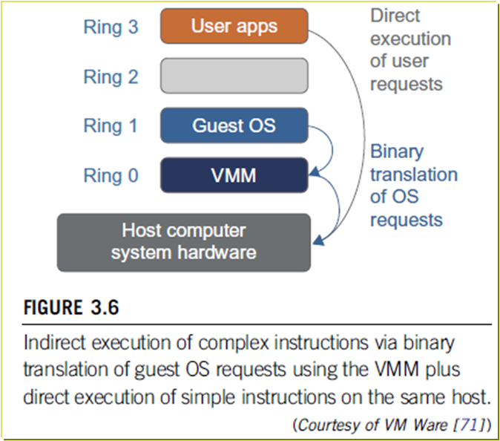
Binary Translation of Guest OS Requests using a VMM
This approach - implemented by VMware & many other software companies.
As in Figure 3.6, VMware puts VMM at Ring 0 and the guest OS at Ring 1.
The VMM scans the instruction stream and identifies the privileged, control- and behavior-sensitive instructions.
When these instructions are identified, they are trapped into VMM, which emulates the behavior of these instructions.
The method used in this emulation is called binary translation.
Therefore, full virtualization combines binary translation and direct execution.

Slide 10
The guest OS is completely decoupled from the underlying hardware.
Consequently, the guest OS is unaware that it is being virtualized.
The performance of full virtualization may not be ideal, because it involves binary translation which is rather time-consuming.
In particular, the full virtualization of I/O-intensive applications is a really a big challenge.

Slide 11
Host-Based Virtualization
An alternative VM architecture is to install a virtualization layer on top of the host OS.
This host OS is still responsible for managing the hardware.
The guest OSes are installed and run on top of the virtualization layer.
This host based architecture has some distinct advantages:
1) User can install this VM architecture without modifying the host OS.
- Virtualizing software can rely on the host OS to provide device drivers & other low-level services.
- simplify the VM design & ease its deployment.
2) Host-based approach appeals to many host machine configurations.
- performance of the host-based architecture may also be low.
- When an application requests hardware access, it involves four layers of mapping - downgrades performance significantly.

Slide 12
Para-Virtualization with Compiler Support
Para-virtualization needs to modify the guest operating systems.
A para-virtualized VM provides special APIs requiring substantial OS modifications in user applications.
Performance degradation is a critical issue of a virtualized system.
No one wants to use a VM if it is much slower than using a physical machine.
The virtualization layer can be inserted at different positions in a machine software stack.
However, para-virtualization attempts to reduce the virtualization overhead, and thus improve performance by modifying only the guest OS kernel.

Slide 13
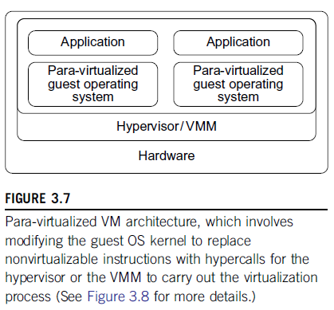
Figure 3.7 illustrates the concept of a para-virtualized VM architecture.
The guest operating systems are para-virtualized.

Slide 14
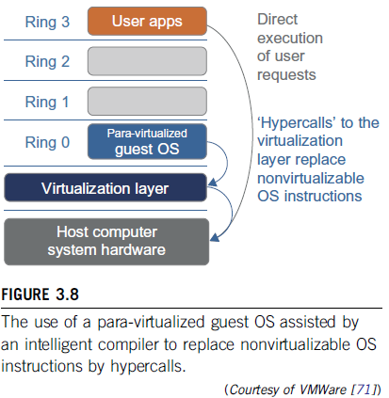
Guest Oses are assisted by an intelligent compiler to replace the nonvirtualizable OS instructions by hypercalls as illustrated in Figure 3.8.
The traditional x86 processor offers four instruction execution rings: Rings 0, 1, 2, and 3.
The lower the ring number, the higher the privilege of instruction being executed.
The OS is responsible for managing the hardware and the privileged instructions to execute at Ring 0, while user-level applications run at Ring 3.
The best example of para-virtualization is the KVM.

Slide 15
Para-Virtualization Architecture
When the x86 processor is virtualized, a virtualization layer is inserted between the hardware and the OS.
According to the x86 ring definition, the virtualization layer should also be installed at Ring 0.
Different instructions at Ring 0 may cause some problems.
In Figure 3.8, we show that para-virtualization replaces nonvirtualizable instructions with hypercalls that communicate directly with the hypervisor or VMM.
Although para-virtualization reduces the overhead, it has incurred other problems.

Slide 16
First, its compatibility and portability may be in doubt, because it must support the unmodified OS as well.
Second, the cost of maintaining para-virtualized OSes is high, because they may require deep OS kernel modifications.
Finally, the performance advantage of para-virtualization varies greatly due to workload variations.
Compared with full virtualization, para-virtualization is relatively easy and more practical.
The main problem in full virtualization is its low performance in binary translation.
To speed up binary translation is difficult.
Therefore, many virtualization products employ the para-virtualization architecture. The popular Xen, KVM, and VMware ESX are good examples.

Slide 17
KVM (Kernel-Based VM)
This is a Linux para-virtualization system—a part of the Linux version 2.6.20 kernel.
Memory management and scheduling activities are carried out by the existing Linux kernel.
The KVM does the rest, which makes it simpler than the hypervisor that controls the entire machine.
KVM is a hardware-assisted para-virtualization tool, which improves performance and supports unmodified guest OSes such as Windows, Linux, Solaris, and other UNIX variants.

Slide 18
Para-Virtualization with Compiler Support
Unlike the full virtualization architecture which intercepts and emulates privileged and sensitive instructions at runtime, para-virtualization handles these instructions at compile time.
The guest OS kernel is modified to replace the privileged and sensitive instructions with hypercalls to the hypervisor or VMM. Xen assumes such a para-virtualization architecture.
Guest OS running in a guest domain may run at Ring 1 instead of at Ring 0.
This implies that the guest OS may not be able to execute some privileged and sensitive instructions.
The privileged instructions are implemented by hypercalls to the hypervisor.
After replacing the instructions with hypercalls, the modified guest OS emulates the behavior of the original guest OS.

